Slide 1

Teaching and Salary Data
Faculty Assembly
May 11, 2017
Michael Halleran, Provost

Slide 2
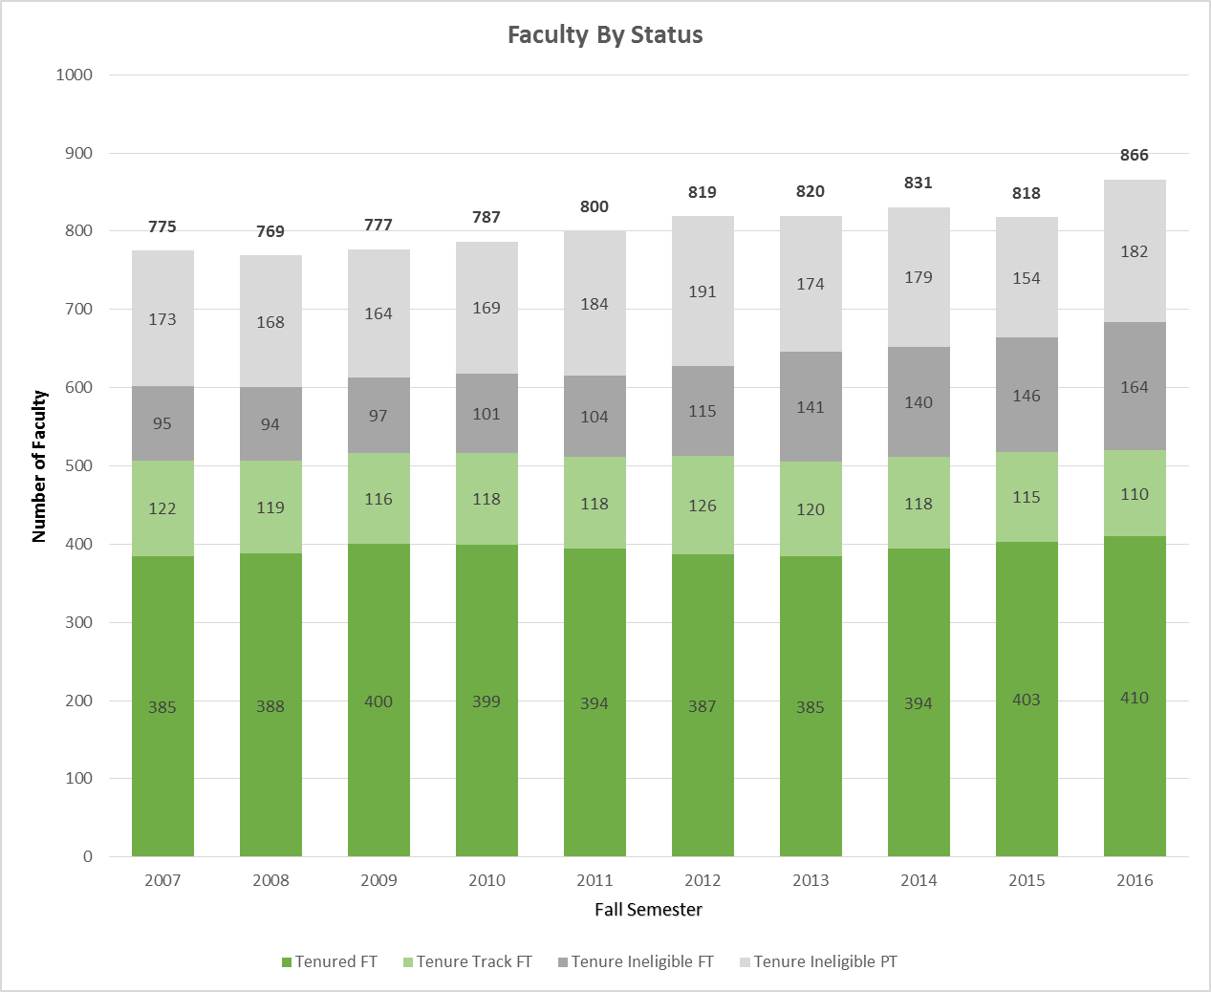

Slide 3
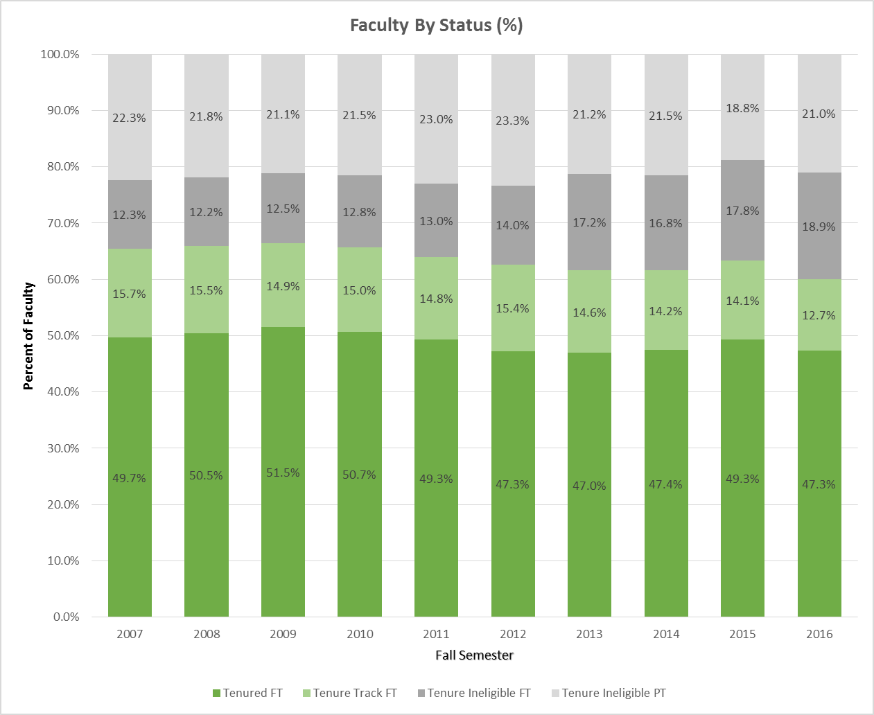

Slide 4
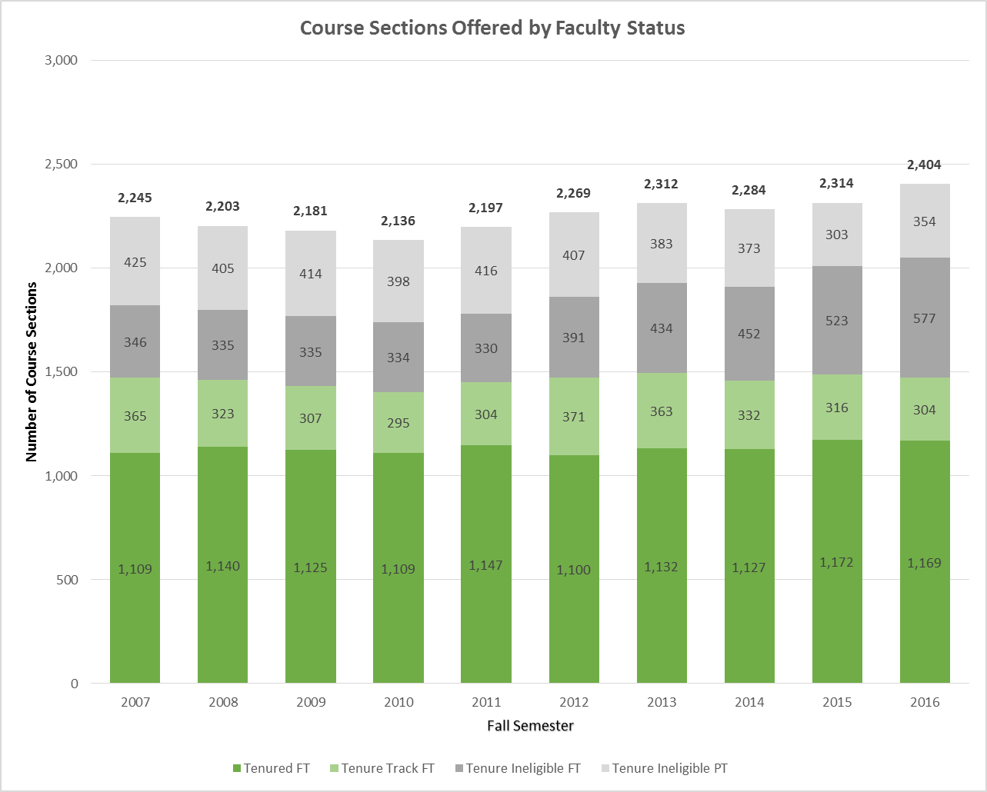

Slide 5
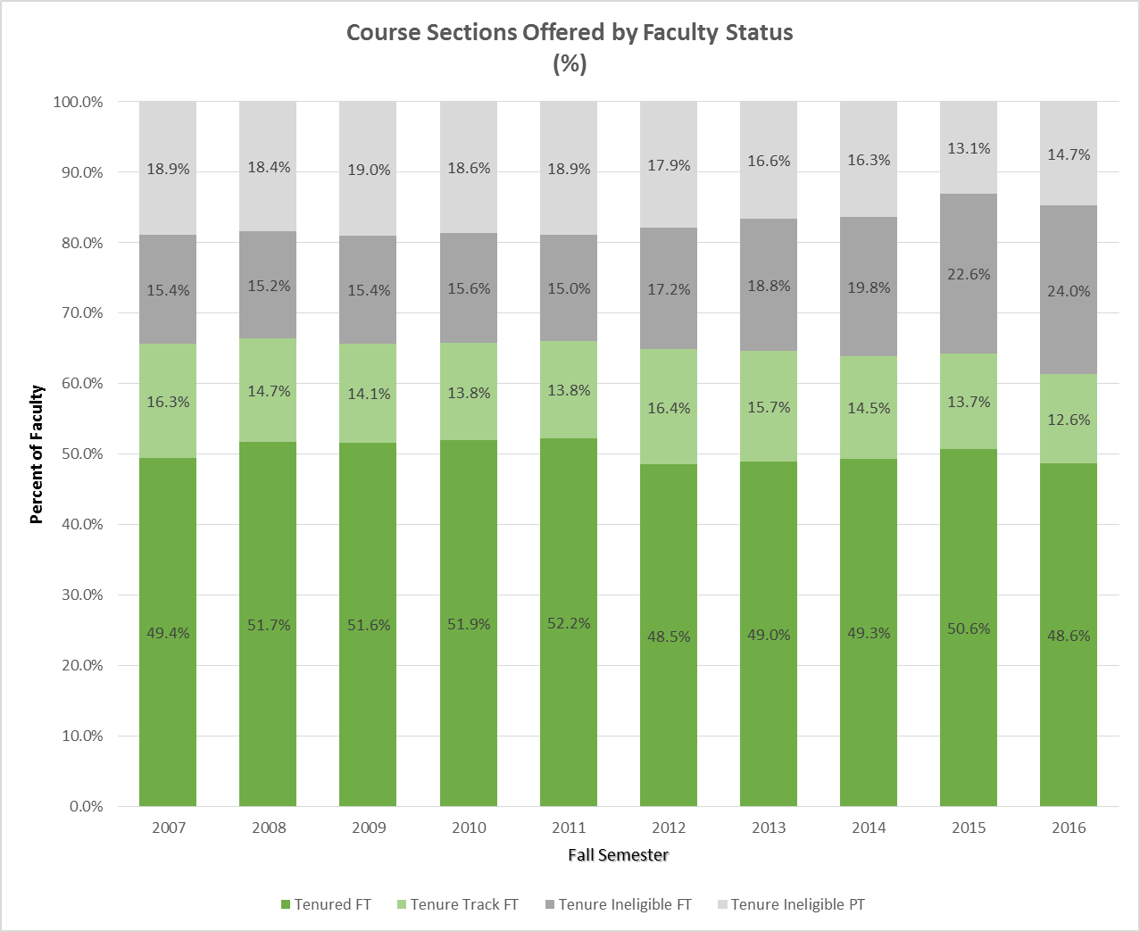

Slide 6
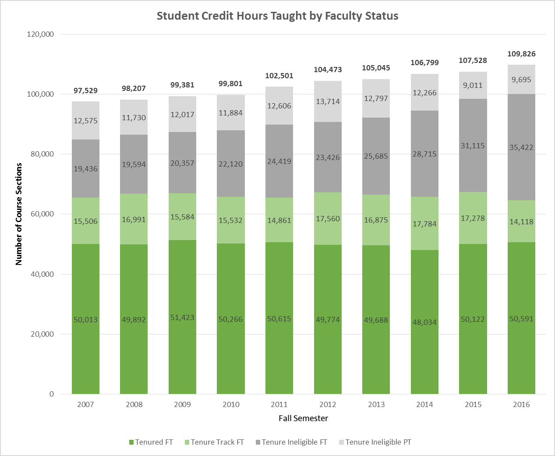

Slide 7
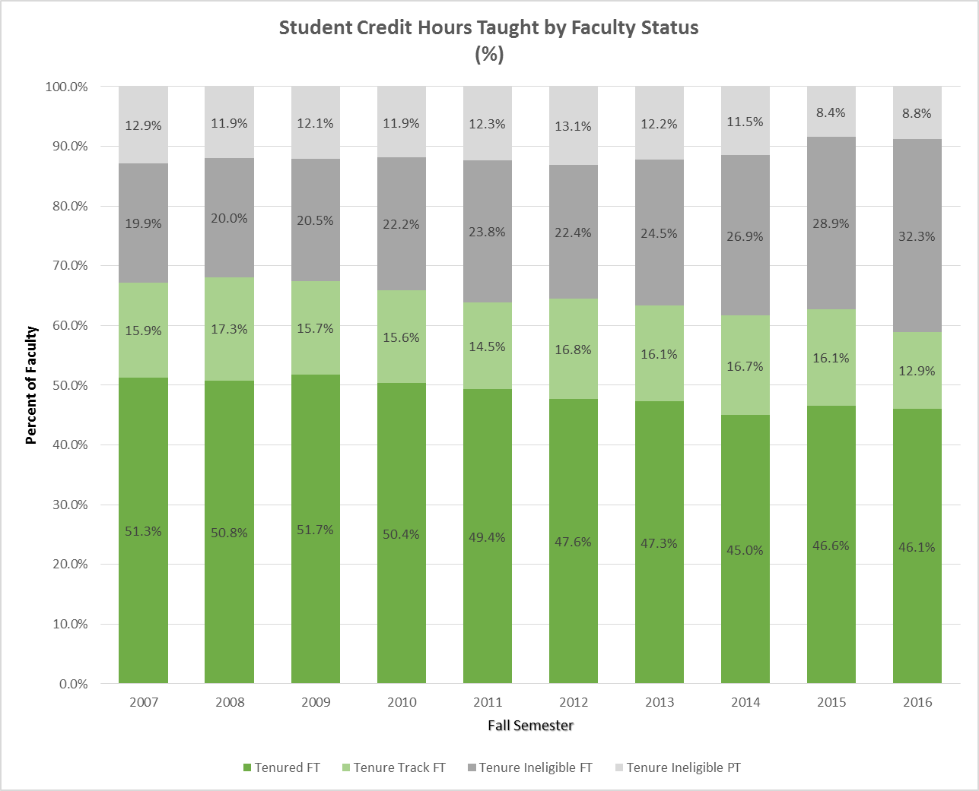

Slide 9
Why did the gap increase in FY16?
W&M made gains, but so did our peers.
Peers made much more substantial gains in FY16 than in prior years, and the 60th percentile target moved accordingly.
 | FY2010 | FY2011 | FY2012 | FY2013 | FY2014 | FY2015 | FY2016
60th Pctl. | $101,705 | $105,076 | $107,109 | $106,965 | $110,014 | $111,956 | $117,252
Change from Prior FY | -$696 | $3,372 | $2,033 | -$144 | $3,049 | $1,942 | $5,296

